Slide 1
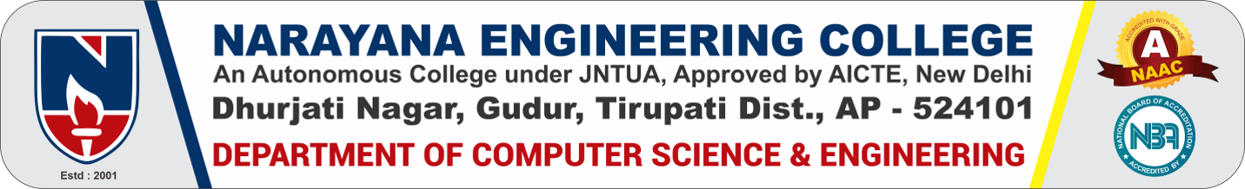
Batch - 09
Smart Classroom Monitoring System Using Face Recognition and Timetable Alerts Using Deep Learning
Under the guidance of
Dr.P.K.VenkateswaraLal, Ph.D, Professor
SUBMITTED BY:
P.JASMINE (22F11A0541)
CH.VARSHITHA(22F11A0512)
M.DIVYA SRI(22F11A0530)
E.TEJASWANI(22F11A0516)

Slide 2
INTRODUCTION
In many educational institutions, classrooms are often left unsupervised due to faculty unavailability, leading to disruptions and reduced learning. Manual monitoring is inefficient, especially on large campuses. To overcome this, we propose a web-based smart classroom supervision system using Python, OpenCV, Flask, face recognition libraries, and Twilio SMS API. A webcam module detects the presence of registered faculty in real time through face recognition. The system is linked to the institution's class timetable, sending automated SMS reminders to faculty before their scheduled classes to improve punctuality. A web dashboard displays the current status of classrooms using green or red indicators, helping administrators monitor multiple rooms efficiently. The system ensures non-intrusive and privacy-respecting monitoring—no video recordings are stored. This solution is efficient, scalable, and well-suited for modern campuses aiming to improve classroom supervision and teaching quality through automation and smart technologies.

Slide 3
TECHNOLOGIES USED
Python - A popular programming language used to build the backend logic of the system.
OpenCV- A library used to process images and videos — helps detect and recognize faces using the
webcam.
Face Recognition Library - Python-based library that identifies registered faculty faces accurately.
Flask - A lightweight web framework used to create the web dashboard that shows classroom status.
Twilio API - Sends SMS alerts to faculty before class.
Webcam- Captures real-time images of the classroom to detect faculty presence.
Faculty Timetable (Database) - Stores class schedules to trigger timely alerts and check for
attendance.
HTML/CSS (for UI) - Used to design the visual web dashboard interface for real-time classroom monitoring.

Slide 4
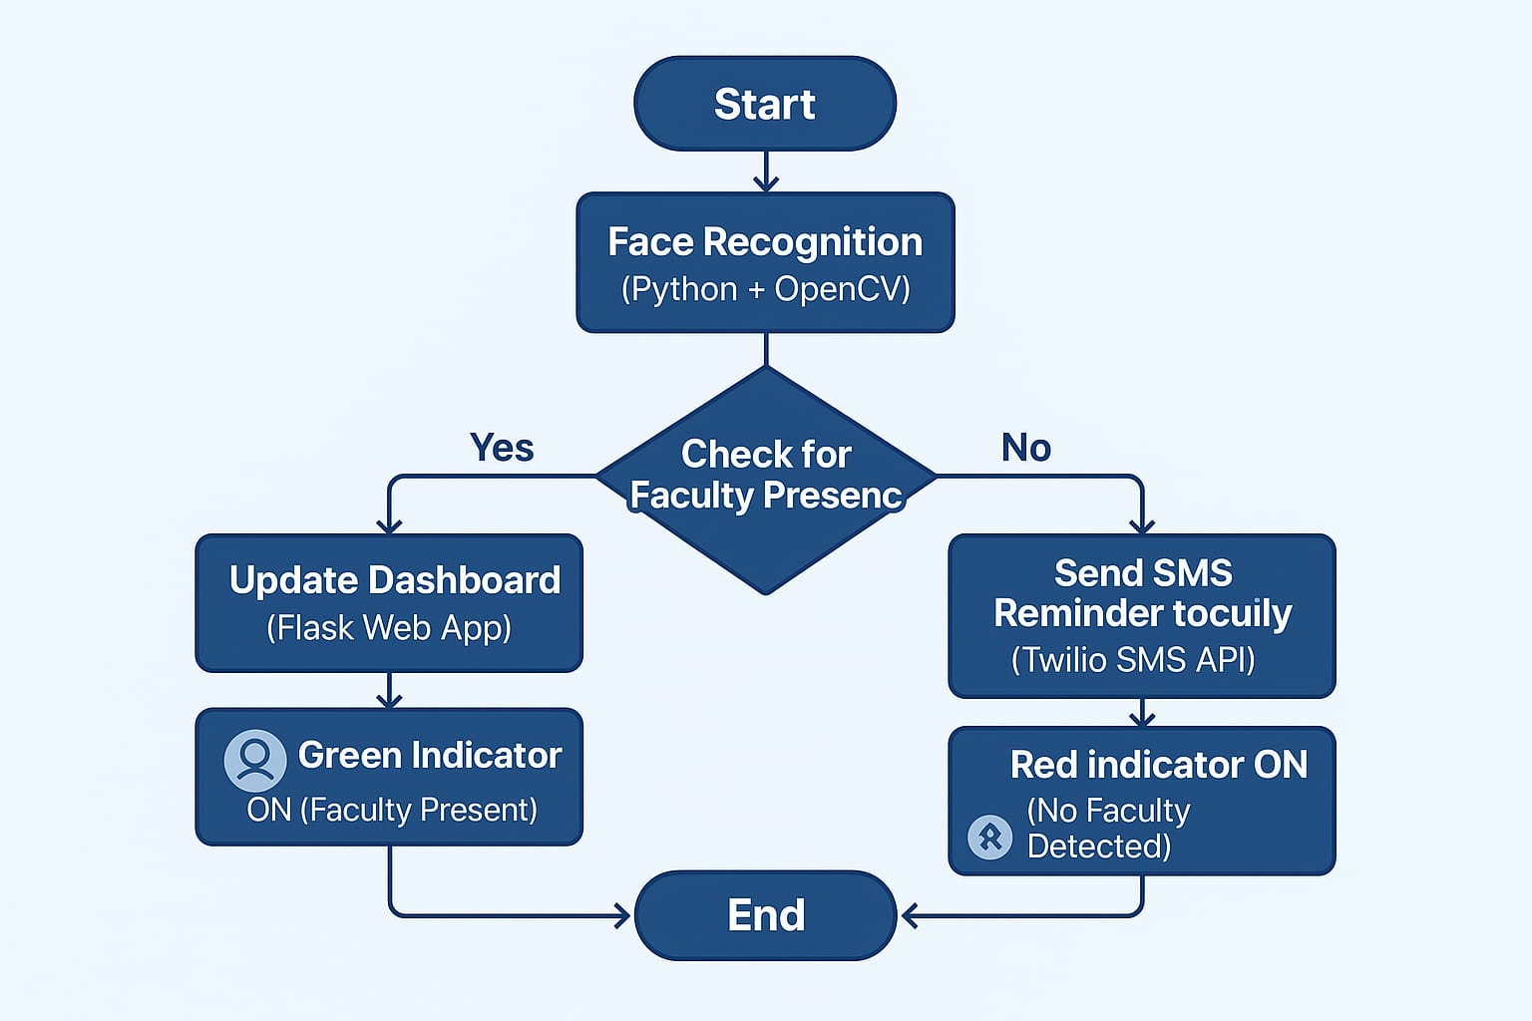
PROJECT WORK FLOW DIAGRAM

Slide 5
EXISTING SYSTEM
In many educational institutions, there is no automated system to verify if classrooms are being properly supervised. Relying on manual checks is time-consuming, inefficient, and impractical— especially across large campuses. While some existing systems attempt to track faculty entry and exit, they often raise concerns about privacy and continuous surveillance. Moreover, the absence of an alert or reminder mechanism means faculty may miss or arrive late to their scheduled classes, further affecting the quality and consistency of education delivery.
DISADVANTAGES OF EXISTING SYSTEM
Manual Monitoring is Time-Consuming
No Real-Time Supervision
No Visual Dashboard
Privacy Concerns in Some Systems
No Remainder System

Slide 6
PROPOSED SYSTEM
The proposed system utilizes a Python-based face recognition algorithm to accurately detect the presence of faculty members in classrooms. It features a web-based dashboard that visually represents the supervision status of each classroom using color-coded indicators. Additionally, the system cross- references the faculty timetable and automatically sends SMS reminders to instructors before their scheduled classes, promoting punctuality and reducing the chances of unsupervised sessions.
ADVANTAGES OF PROPOSED SYSYTEM
Automated Monitoring Saves Manual Work
Real-Time Supervision Enabled
Visual Dashboard for Admins
Privacy-Friendly Design
Built-in Remainder System

Slide 7
CONCLUSION
The Smart Classroom Monitoring System offers an efficient, automated solution to traditional classroom supervision challenges. By using face recognition, a real-time visual dashboard, and timetable-linked SMS alerts, it ensures classes are continuously monitored. Designed to be lightweight, scalable, and privacy-respecting, the system suits institutions of all sizes. Its non-intrusive setup reduces manual workload, improves accountability, and minimizes class disruptions. With its smart integration of technology, the system not only enhances classroom management but also supports a better learning environment, making it a practical and forward- thinking tool for modern educational institutions.

